Slide 1
program
growth mindset
discussion
Notes:
Hi, my name is ________.
I want to start my presentation by asking each and every one of you, to think about how you would describe this picture on the screen:
And I would like for some of you to share that with me. How would you describe this picture?
… (get several answers)…
now, who thinks that this person is putting in effort to lift the weights? (raise my hand to ask people to raise hands)
why – why do you think that people put in effort when they’re lifting weights?

Slide 2
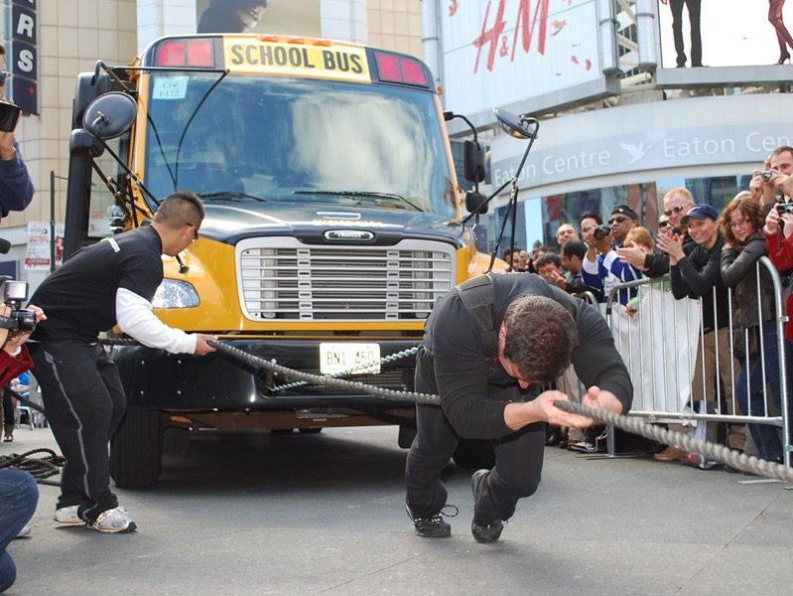

program
growth mindset
discussion
Rafael Garcia
Tsar Kasim
Notes:
If you work your muscles… You get strong muscle

Slide 3


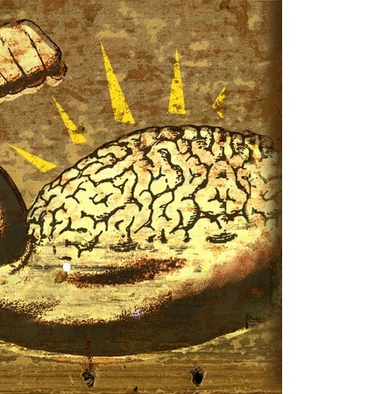
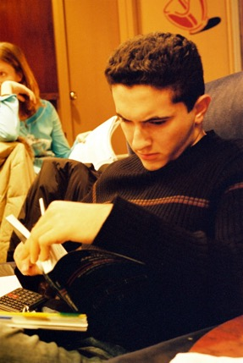
m00by
xb3 / Francis
Applied Nomadology
John Althouse Cohen
Notes:
If you work your brain… You get strong brains

Slide 4
Notes:
The brain is like a muscle. We have to put in effort, in order for it to grow and get stronger.

Slide 5

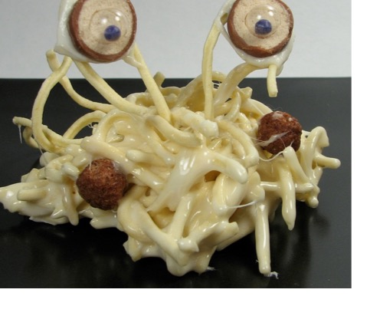
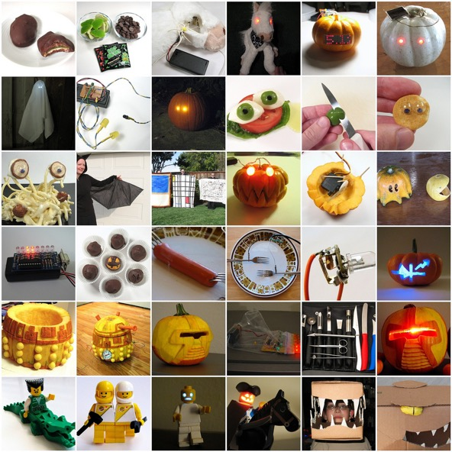
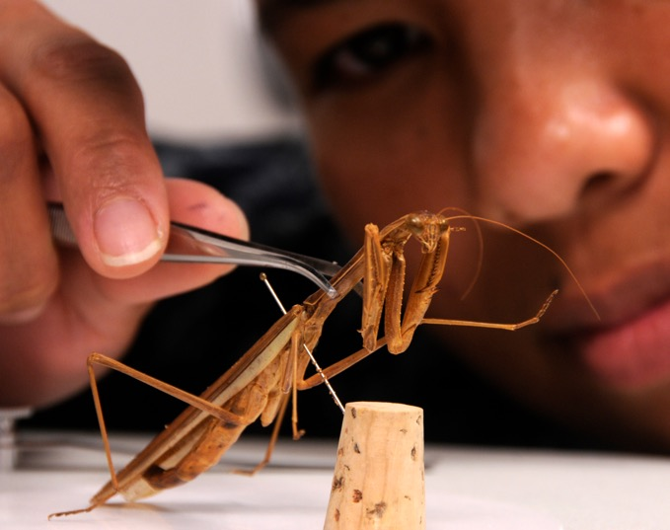

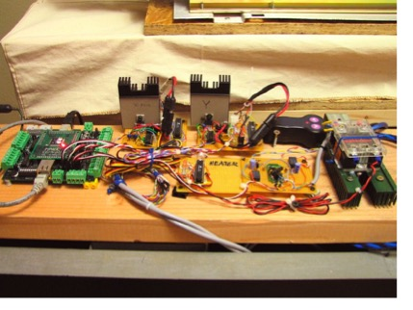

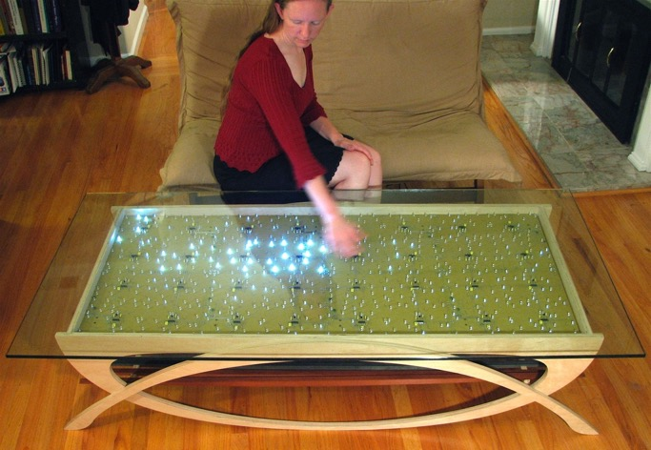
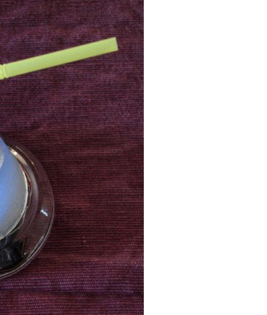
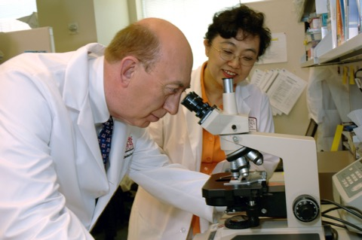
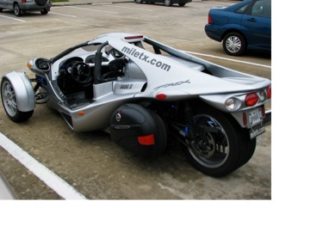
Windell H. Oskay, www.evilmadscientist.com
Windell H. Oskay, www.evilmadscientist.com
Lcrward
Lenore M. Edman, www.evilmadscientist.com
Lori Greig
Windell H. Oskay, www.evilmadscientist.com
Windell H. Oskay, www.evilmadscientist.com
Notes:
And why do we want our brains to be stronger? (picture of arnold the brain)
Because wit strong brains we can do have a lot of fun and amazing things!
We can create lots of very cool things
We can discover many things about the world
We can solve lots of tough problems, including improving our health, our environment and our lifestyles
And we can focus, so that we can meet our objectives
Other possibilities:
Do math
Read, etc.
We can discover new truths about the world we live in (picture of scientist with insect)
Create cool stuff (animation things)
Read well
Draw neat things
Focus, and persevere (sports image)
Invent things (picture of guy with wings)

Slide 6
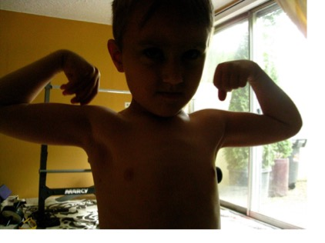
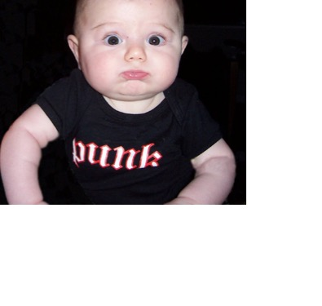
eyeliam
Neeta Lind
Notes:
…The coolest thing is that, just like no one was born with crazy huge muscles (picture of very thin man or charicature, and maybe of baby with crazy muscles…
…No one was born with crazy strong brains…

Slide 7
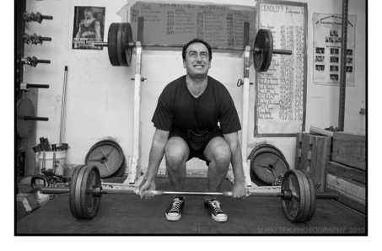

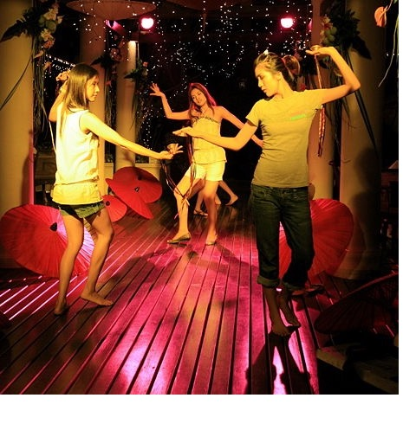
Steve Jurvetson
Ron Sombilon
Steve Jurvetson
Notes:
So just like we need to practice in order to get strong and be able to do very cool things with our body…

Slide 8


m00by
MC Quinn
Notes:
…we can work hard to get strong brains…

Slide 9
Mindsets
Fixed Mindset
Growth Mindset
Intelligence is a fixed trait
Intelligence is a malleable quality, a potential that can be developed

Slide 10
The Impact of Growth Mindset
Looking Smart is Most Important
Learning is Most Important
Effort is Negative
Effort is positive
Helpless
Resilient

Slide 11
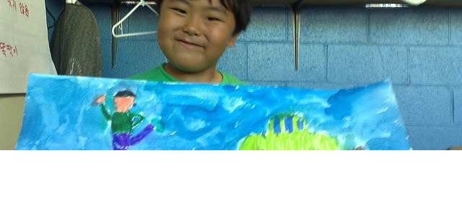
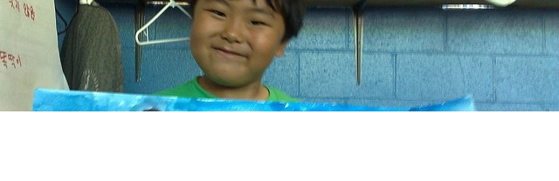
Math Achievement in Junior HS
Math Grades
Korean Resource Center
Korean Resource Center
Notes:
…and it turns out that kids who understand this, do better in school and out of school than kids who don’t know this yet…
This chart shows that students who understand this get better grades in math than students who don’t know this yet

Slide 12
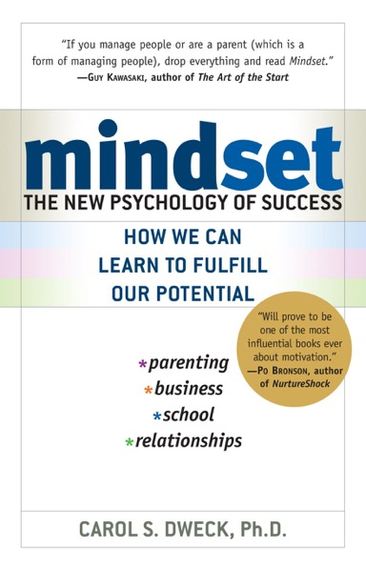
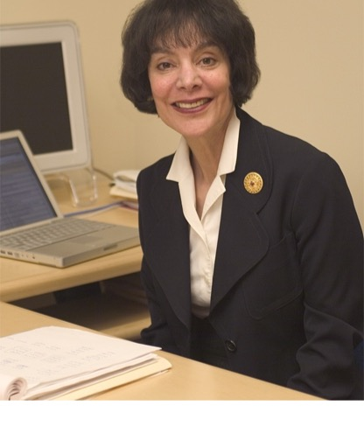
Notes:
This was discovered by a professor of psychology at Stanford University by the name of Carol Dweck
…and parents and teachers who want to learn more about this research may be interested in a very accessible book she wrote called Mindset, which is available for $10 at Amazon.com…
So Dr. Dweck discovered that kids who understand that intelligence is developed over time do better in school and out of school.
But then she started asking herself the question – well, if we teach kids that intelligence is developed over time, do those kids who don’t know that yet start doing better in school?
And so she set out to teach them that, and…

Slide 13
Growth Mindsets Influences:
Goals
Fixed Mindset Students Say
Growth Mindset Students Say
Looking Smart is Most Important
“The main thing I want when I do my school work is to show how good I am at it.”
Learning is Most Important
“It’s much more important for me to learn things in my classes than it is to get the best grades.”

Slide 14
Growth Mindsets Influences:
Effort Beliefs
Fixed Mindset Students Say
Growth Mindset Students Say
Effort is negative
“To tell the truth, when I work hard at my school work it makes me feel like I’m not very smart.”
Effort is positive
“The harder you work at something, the better you’ll be at it.”

Slide 15
Growth Mindsets Influences:
Strategies After Failure
Fixed Mindset Students Say
Growth Mindset Students Say
Helpless
“I would spend less time on this subject from now on.”
“I would try not to take this subject ever again.”
“I would try to cheat on the next test.”
Resilient
“I would work harder in this class from now on.”
“I would spend more time studying for the tests.”

Slide 16
Study on
Students Making a Transition to 7th Grade, from:
Blackwell, L., Trzesniewski, K., & Dweck, C.S. (2007).
Implicit Theories of Intelligence Predict Achievement Across an Adolescent
Transition: A Longitudinal Study and an Intervention.
Child Development, 78. 246-263.

Slide 17
Growth Mindset Material Used
The growth mindset training used a
4-page article developed for the study
  you can read this article at:
  http://www.mindsetworks.com/websitemedia/youcangrowyourintelligence.pdf

Slide 18
Change in Math Grades
Math Grades
Notes:
..and hence she discovered when kids learn this, they do better in school.
This chart shows the results from one of the studies in which they taught kids that intelligence is something that they develop over time, showing how the kids who learned this started doing a lot better in school than the kids who didn’t have the opportunity to take the class.

Slide 19
Noticeable Motivation Increase
% Identified as Increasing in Motivation
Notes:
Not only that, but the adults around the student can notice meaningful changes in the behavior of the child. They get motivated to become active learners and take charge over the growth of their own brain and over their own success.

Slide 20
Study on
How Mindsets Are Communicated from:
Mueller, C. M. & Dweck, C. S. (1998).
Intelligence praise can undermine motivation and performance.
Journal of Personality and Social Psychology, 75, 33-52.

Slide 21
Each student worked on a non-verbal IQ test & was given one kind of praise
Intelligence Praise
Effort Praise
“Wow, that’s a really good score. You must be smart at this.”
“Wow, that’s a really good score. You must have tried really hard.”
Control Group
“Wow, that’s a really good score.”

Slide 22
# of problems solved on the IQ test
# of Problems Solved
Before Failure
After Failure

Slide 23
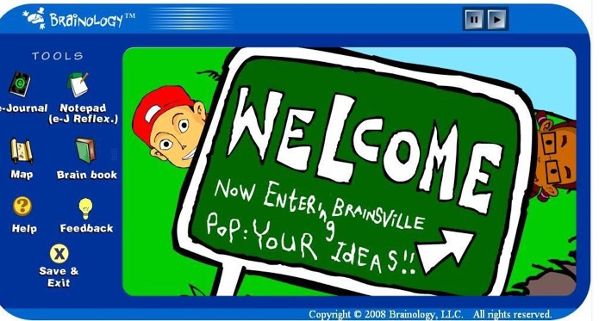
The Brainology® Program
Notes:
…so Dr. Dweck and some colleagues created a fun, online program, that teaches kids that the brain is like a muscle, and what they need to do in order to strengthen their own brains… (then go into description and website)…
The program is all accessed online.
So in the program kids go on a quest,
And they meet characters like Chris and Dahlia…

Slide 24
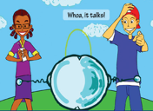

The Brainology® Program
Interactive, online program to cultivate a growth mindset.
Students follow animated characters as they tackle issues in their most difficult subjects.
Brainology® Growth Process:

Slide 25
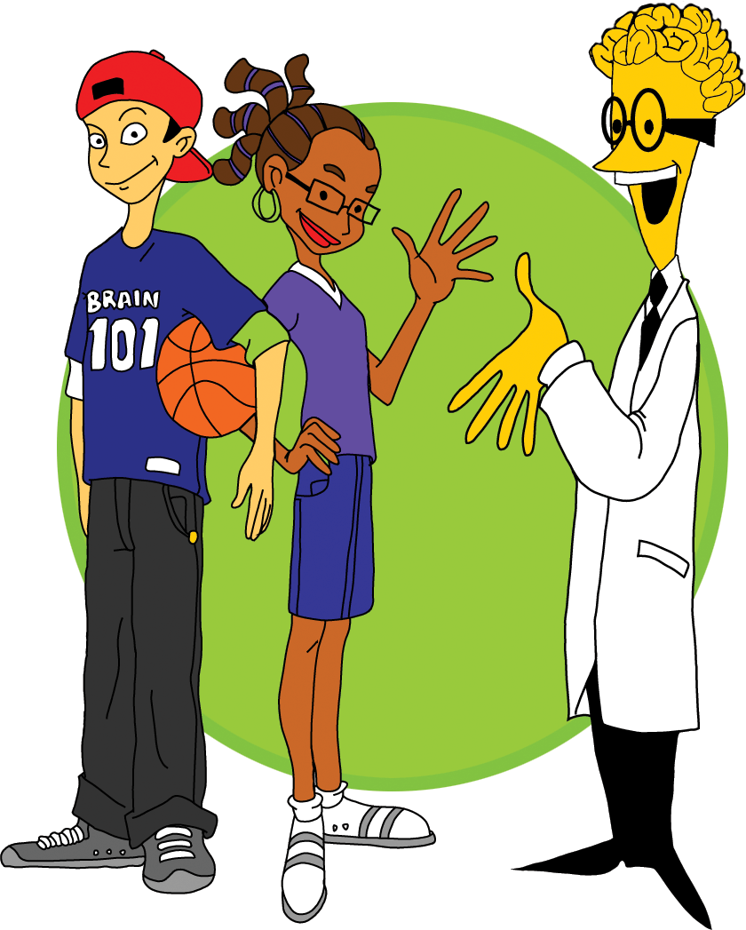
Notes:
…and some other characters, like Dr. Cerebrus, the brain dude and the Orb…
And they embark on a fun exploration with lots of humor, but also lots of really useful learning

Slide 26


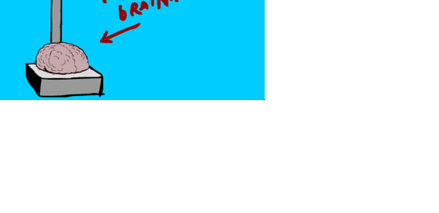
Notes:
…along the way you learn really cool, things, like when you put rats in a stimulating environment, where they need to be using their brains all the time, as opposed to a boring environment, with not much to do… their brains get heavier..
…that’s because the rats that are working out their brains, y using their brains actively all the time, are making their brains stronger
or if you look at the brains of taxi drivers, the area where they store information about space is much bigger than for other people, because they need to be thinking about space all the time….

Slide 27
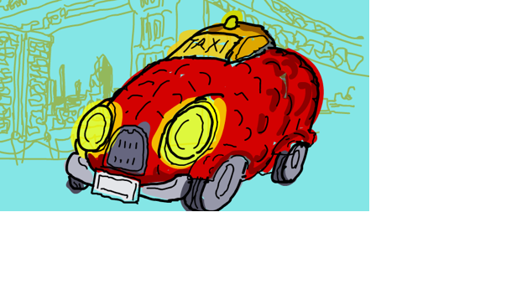
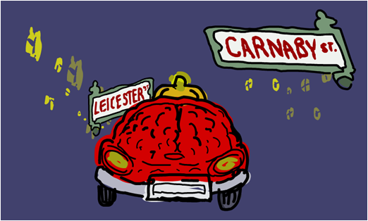

Notes:
…along the way you learn really cool, things, like when you put rats in a stimulating environment, where they need to be using their brains all the time, as opposed to a boring environment, with not much to do… their brains get heavier..
…that’s because the rats that are working out their brains, y using their brains actively all the time, are making their brains stronger
or if you look at the brains of taxi drivers, the area where they store information about space is much bigger than for other people, because they need to be thinking about space all the time….

Slide 28
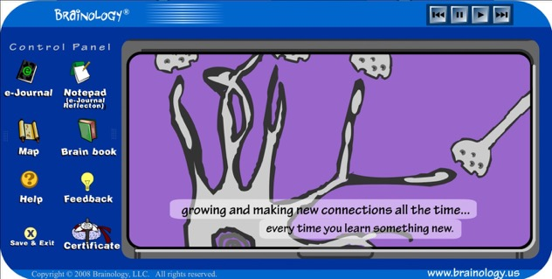
Notes:
…along the way you learn really cool, things, like when you put rats in a stimulating environment, where they need to be using their brains all the time, as opposed to a boring environment, with not much to do… their brains get heavier..
…that’s because the rats that are working out their brains, y using their brains actively all the time, are making their brains stronger
or if you look at the brains of taxi drivers, the area where they store information about space is much bigger than for other people, because they need to be thinking about space all the time….

Slide 29

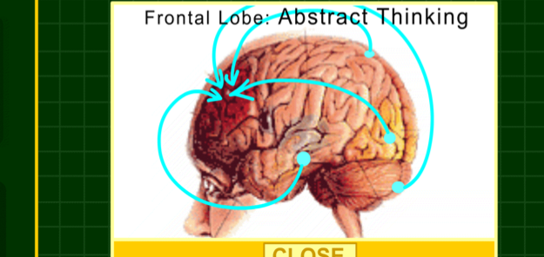
Notes:
…along the way you learn really cool, things, like when you put rats in a stimulating environment, where they need to be using their brains all the time, as opposed to a boring environment, with not much to do… their brains get heavier..
…that’s because the rats that are working out their brains, y using their brains actively all the time, are making their brains stronger
or if you look at the brains of taxi drivers, the area where they store information about space is much bigger than for other people, because they need to be thinking about space all the time….

Slide 30
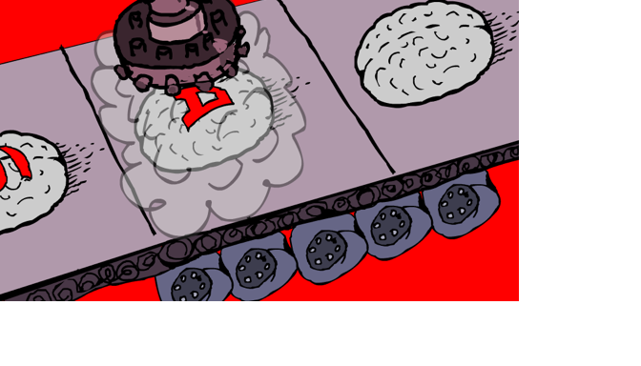
Notes:
…and why do we want strong brains?…
So that we can do lots of cool stuff (lots of images again)…

Slide 31
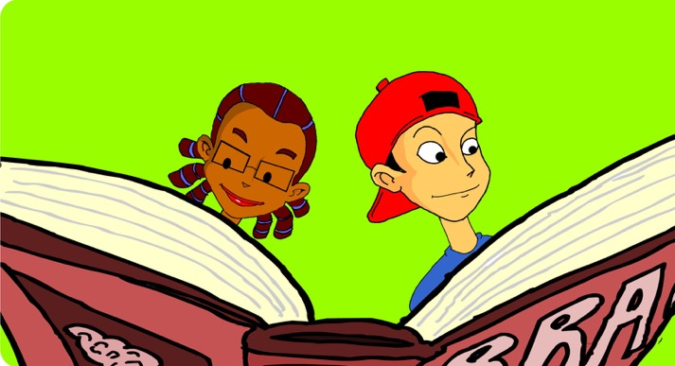
Notes:
Kids also learn about effective study strategies that work best, based on what they’re learning about how the brain works.
So they learn why certain study strategies make sense.

Slide 32
Notes:
…so kids learn lots of cool stuff like that, and they also learn how they can work out their own brains, so that their brains grow stronger [image of strong brain…] … how to boost…

Slide 33
Student responses to the question : Have you changed your mind about anything?
“I did change my mind about how the brain works …I will try harder because I know that the more you try the more your brain works.”
“Yes … I imagine neurons making connections in my brain and I feel like I am learning something.”
“My favorite thing from Brainology is the neurons part where when u learn something there are connections and they keep growing. I always picture them when I’m in school.”

Slide 34
Teacher Response to the question:
Have you noticed changes in your students?
“[In my class they] use the memory terminology every chance they get:
‘I’ll have to put that into my long-term memory.’
‘Sorry, that stuff is not in my long-term memory.’
‘I guess I was only using my working memory.’
…They offer to practice, study, take notes, or pay attention to ensure that connections will be made.”

Slide 35
Why use Brainology® to Motivate Students?
Research-based program fully focused on the growth mindset, which leads to motivation & self-efficacy
Motivation & self-efficacy are the most powerful levers to catalyze student learning
Engages students in a fun, interactive way, in relevant context, so that they’re receptive to it
Ensures, consistent, comprehensive, high quality delivery across classrooms, schools and districts

Slide 36

Thank you!
®
www.mindsetworks.com
Notes:
…for all those kids and parents who want to learn more about the Brainology program, you can Google ‘brainology’, or you can go to the website at www.mindsetworks.com…
Thank you… [any questions?...]

